Slide 1
C1 Elementary Chinese Course​​
Lesson one: Nationality
2.2 Pre-class

Slide 2
Intended Learning Outcomes:
After watching the video, you should be able to:
1. Say country names​ in Chinese
2. Ask for someone's nationality ​
3. Introduce your own nationality​

Slide 3
Sentence structure
我 是 中国 人。
wǒ shì Zhōngguó rén
我是
wǒ shì
I am
Country
人
Rén
Person
Introducing your nationality
Notes:
If you want to introduce your nationality, you can use the sentence structure 我 是 + country+ 人 to express it. For example if I am Chinese, I can say 我 是 中国人。 中国 means “China“ and 人 means ”person“。 Try to practice the sentence structure, so that you can introduce yourself to others about your nationality.

Slide 4

Learn more about how to say country names in Chinese!
Notes:
Now let’s learn more about how to say country names in Chinese.

Slide 5






Can you find your country?
美国 (U.S)​ | Měiguó ​ | ​
中国​(China) | Zhōngguó ​ | ​
法国​(France) | Fǎguó ​ | ​
英国​(Britain) | Yīngguó ​ | ​
德国​(Germany) | Déguó ​ | ​
韩国​(Korea) | Hánguó ​ | ​

Slide 6






Can you find your country?
日本​(Japan) | Rì běn ​ | ​
印度尼西亚(印尼） (Indonesia)​ | Yìn dù ní xī yà(Yìn ní )​ | ​
印度​(India) | Yìn dù ​ | ​
巴基斯坦​(Pakistan) | Bā jī sī tǎn ​ | ​
加拿大​(Canada) | Jiā ná dà ​ | ​
新加坡​(Singapore) | Xīn jiā pō | ​

Slide 7







How to tell others about your nationality?
美国​ | Měiguó ​ | ​ 人​ rén​ ​ ​ | Měiguó rén​ ​
中国​ | Zhōngguó ​ |  | Zhōngguó rén​ ​
法国​ | Fǎguó ​ |  | Fǎguó rén​ ​
英国​ | Yīngguó ​ |  | Yīngguó rén​ ​
德国​ | Déguó ​ |  | Déguó rén​ ​
韩国​ | Hánguó ​ |  | Hánguó rén​
Notes:
The way to tell others about your nationality is very easy, you simply add the character 人,meaning person, after the country. For example American, you can say 美国人。
加个quiz. 比如放一个美国国旗，有两个选项。A我是美国。 B 我是美国人。

Slide 8

Where are you from?
Q: 你是哪国人？nǐ shì nǎ guó rén？​
A: 我是英国人。I am British.
Wǒ shì Yīngguó rén.
哪 nǎ:which
国 guó :country
Notes:
Now, let's learn how to ask for someone's nationality. In this video, we are going to learn three ways to ask for nationality.
The common question is " 你是哪国人？”
哪 means "which"，国 means "country"， so “ 你是哪国人？”is asking which country you come from. Where are you from?

Slide 9
Where are you from?
Q: 你是哪国人？nǐ shì nǎ guó rén？​
A: Wǒ + shì + country + rén
哪 nǎ:which
国 guó :country
Notes:
Can you answer the question "你是哪国人" with the sentence structure 我是+ country + 人 according to your background?
(Wait 20 seconds) Good job! I guess you all know how to introduce your nationality with the correct sentence. Let's move to the second way to ask for nationality.

Slide 10
Where are you from?
你是中国人吗?
Nǐ shì Zhōngguó rén ma?​
Notes:
The sentence 你是中国人吗? means“Are you Chinese ?” ​
“中国Zhōngguó” means China, and “中国人Zhōngguó rén” means Chinese.​

Slide 11
Where are you from?
Q: 你是中国人吗?
Nǐ shì Zhōngguó rén ma? Are you Chinese?
A: 是，我是中国人。 Shì, wǒ shì Zhōngguó rén.​
Yes, I am Chinese.
不是，我不是中国人。Bú shì, wǒ bú shì Zhōngguó rén 。
No, I am not Chinese.
​
Notes:
If someone asks you “ are you Chinese?” , and if your answer is yes, you can say “是，我是中国人。“； if your answer is no, you can say “ 不是，我不是中国人。”

Slide 12
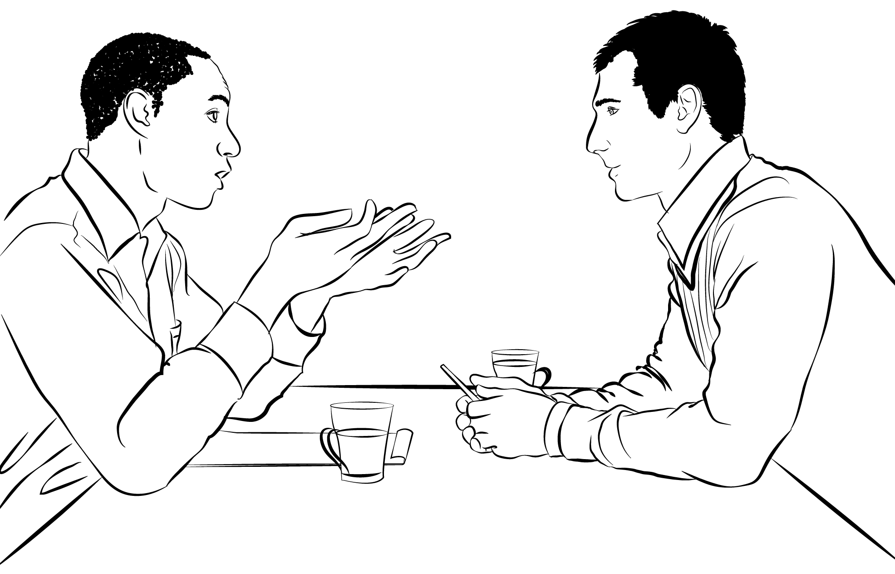
Where are you from?
​
我是中国人，你呢？​( I am Chinese, How about you? )
Wǒ shì zhōngguó rén , nǐ ne?​
我是美国人。(I am American.)
Wǒ shì měiguó rén.
​
Contributor: DragonTiger8
Notes:
The third way to ask about someone’s nationality works like this, you can first introduce where you are from, and then use the phrase ‘ni ne” to ask about others nationality. For example： 我是中国人，你呢？

Slide 13

The end
Thanks for watching.
Credit: Evegesha
Note: All pictures come from ShutterStock and creative commons

